Slide 1
Chapter 8 Project Scheduling

Slide 2
INTRODUCTION
Schedule converts action plan into operating time table
Basis for monitoring and controlling project
Scheduling more important in projects than in production, because unique nature
Sometimes customer specified/approved requirement-e.g: JKR projects
Based on Work Breakdown Structure (WBS)
Chapter 8
Scheduling, PERT, Critical Path Analysis

Slide 3
NETWORK TECHNIQUES
PERT
CPM
Program Evaluation and
Review Technique
developed by the US
Navy with Booz
Hamilton Lockheed
on the Polaris
Missile/Submarine
program 1958
  Critical Path Method
  Developed by El Dupont for Chemical Plant Shutdown Project- about
  same time as PERT
Both use same calculations, almost similar
Main difference is probabilistic and deterministic in time estimation
Gantt Chart also used in scheduling
Chapter 8
Scheduling, PERT, Critical Path Analysis

Slide 4
NETWORK
Graphical portrayal of activities and event
Shows dependency relationships between tasks/activities in a project
Clearly shows tasks that must precede (precedence) or follow (succeeding) other tasks in a logical manner
Clear representation of plan – a powerful tool for planning and controlling project
Chapter 8
Scheduling, PERT, Critical Path Analysis

Slide 5
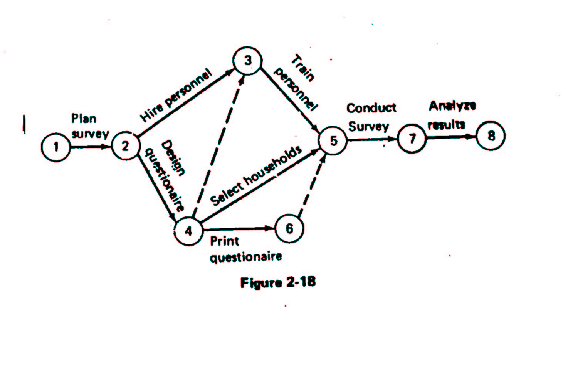
Example of Simple Network –
Survey
Chapter 8
Scheduling, PERT, Critical Path Analysis

Slide 6
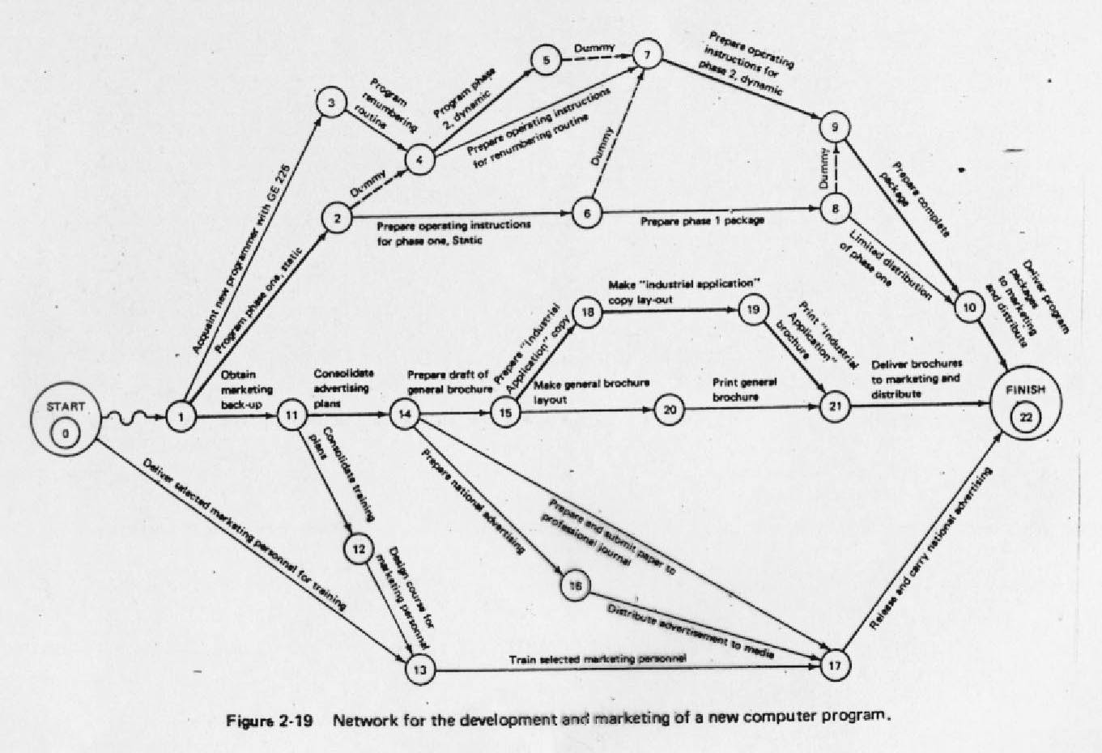
Example of Network –
More Complex
Chapter 8
Scheduling, PERT, Critical Path Analysis

Slide 7
DEFINITION OF TERMS IN A NETWORK
Activity : any portions of project (tasks) which required by project, uses up resource and consumes time – may involve labor, paper work, contractual negotiations, machinery operations Activity on Arrow (AOA) showed as arrow, AON – Activity on Node
Event : beginning or ending points of one or more activities, instantaneous point in time, also called ‘nodes’
Network : Combination of all project activities and the events
PRECEEDING
SUCCESSOR
ACTIVITY
EVENT
Chapter 8
Scheduling, PERT, Critical Path Analysis

Slide 8
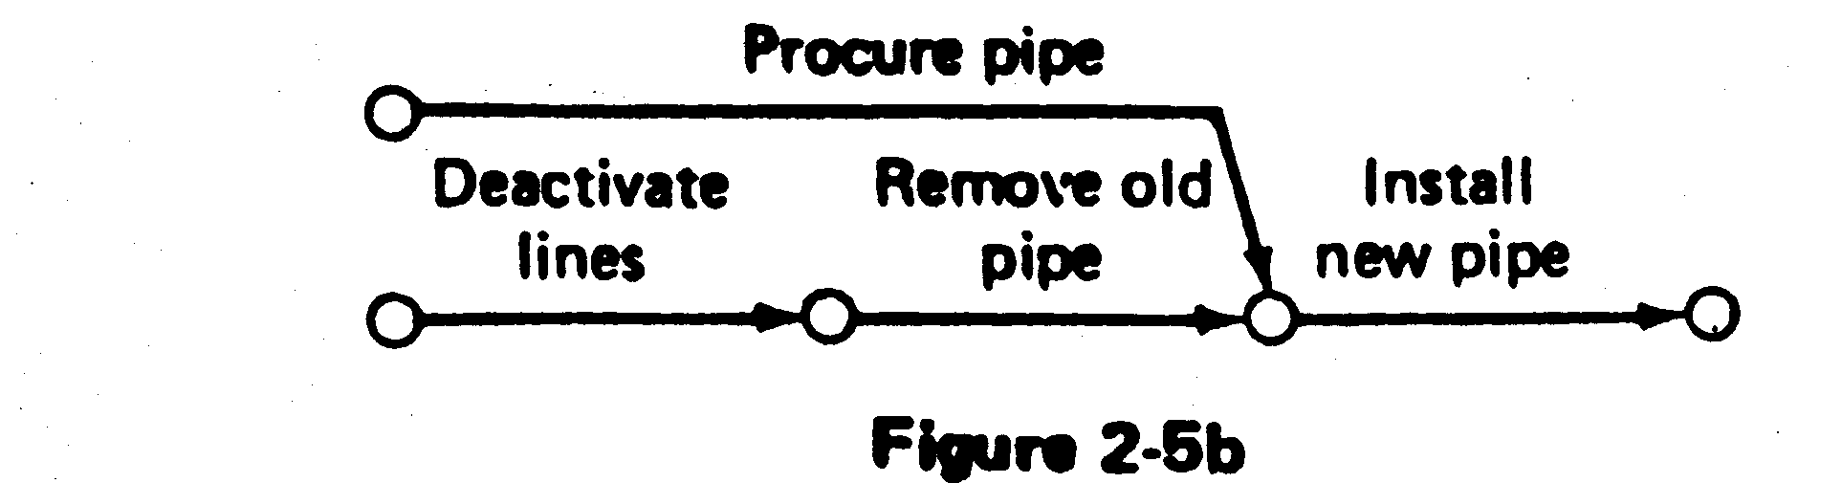
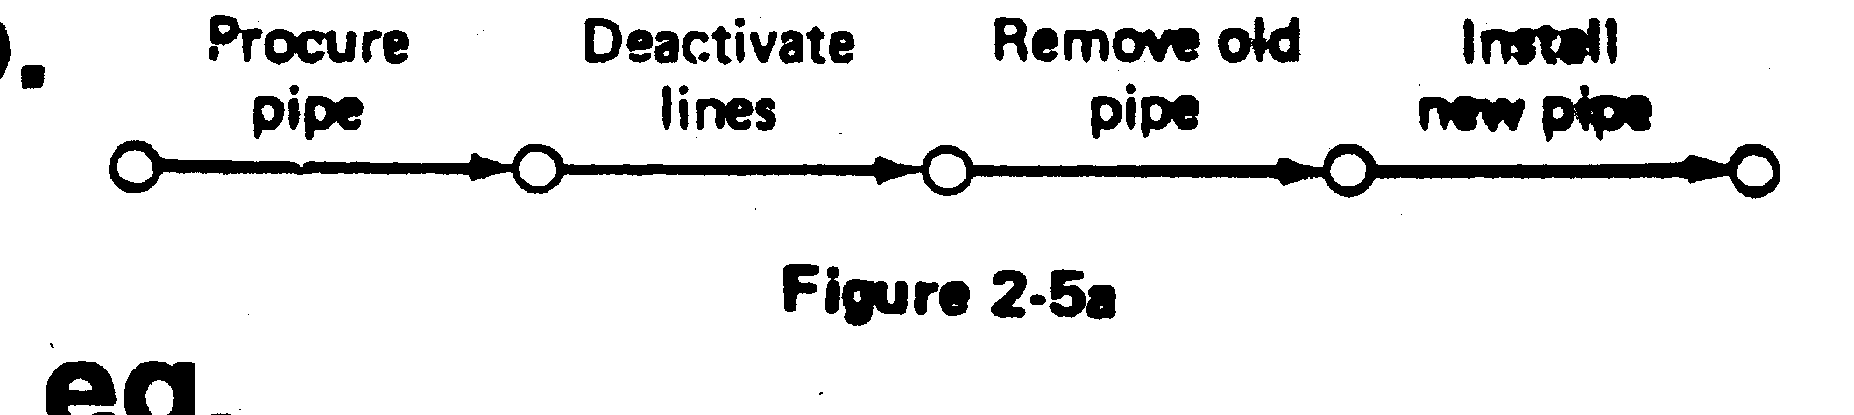
Emphasis on Logic in Network Construction
Construction of network should be based on logical or technical dependencies among activities
Example - before activity ‘Approve Drawing’ can be started the activity ‘Prepare Drawing’ must be completed
Common error – build network on the basis of time logic (a feeling for proper sequence ) see example below
WRONG !!!
CORRECT ✓
Chapter 8
Scheduling, PERT, Critical Path Analysis

Slide 9
Example 1- A simple network
Consider the list of four activities for making a simple product:
Activity Description Immediate
predecessors
A Buy Plastic Body -
B Design Component -
C Make Component B
D Assemble product A,C
Immediate predecessors for a particular activity are the activities that, when completed, enable the start of the activity in question.
Chapter 8
Scheduling, PERT, Critical Path Analysis

Slide 10
Sequence of activities
Can start work on activities A and B anytime, since neither of these activities depends upon the completion of prior activities.
Activity C cannot be started until activity B has been completed
Activity D cannot be started until both activities A and C have been completed.
The graphical representation (next slide) is referred to as the PERT/CPM network
Chapter 8
Scheduling, PERT, Critical Path Analysis

Slide 11
Network of Four Activities
Arcs indicate project activities
A
D
1
3
4
B
C
2
Nodes correspond to the beginning and ending of activities
Chapter 8
Scheduling, PERT, Critical Path Analysis

Slide 12
Example 2
Develop the network for a project with following activities and immediate predecessors:
Activity Immediate
predecessors
A -
B -
C B
D A, C
E C
F C
G D,E,F
Try to do for the first five (A,B,C,D,E) activities
Chapter 8
Scheduling, PERT, Critical Path Analysis

Slide 13
Network of first five activities
A
D
1
3
4
E
B
C
5
2
We need to introduce a dummy activity
Chapter 8
Scheduling, PERT, Critical Path Analysis

Slide 14
Network of Seven Activities
1
A
3
D
4
G
7
dummy
E
B
C
5
F
2
6
Note how the network correctly identifies D, E, and F as the immediate predecessors for activity G.
Dummy activities is used to identify precedence relationships correctly and to eliminate possible confusion of two or more activities having the same starting and ending nodes
Dummy activities have no resources (time, labor, machinery, etc) – purpose is to PRESERVE LOGIC of the network
Chapter 8
Scheduling, PERT, Critical Path Analysis

Slide 15
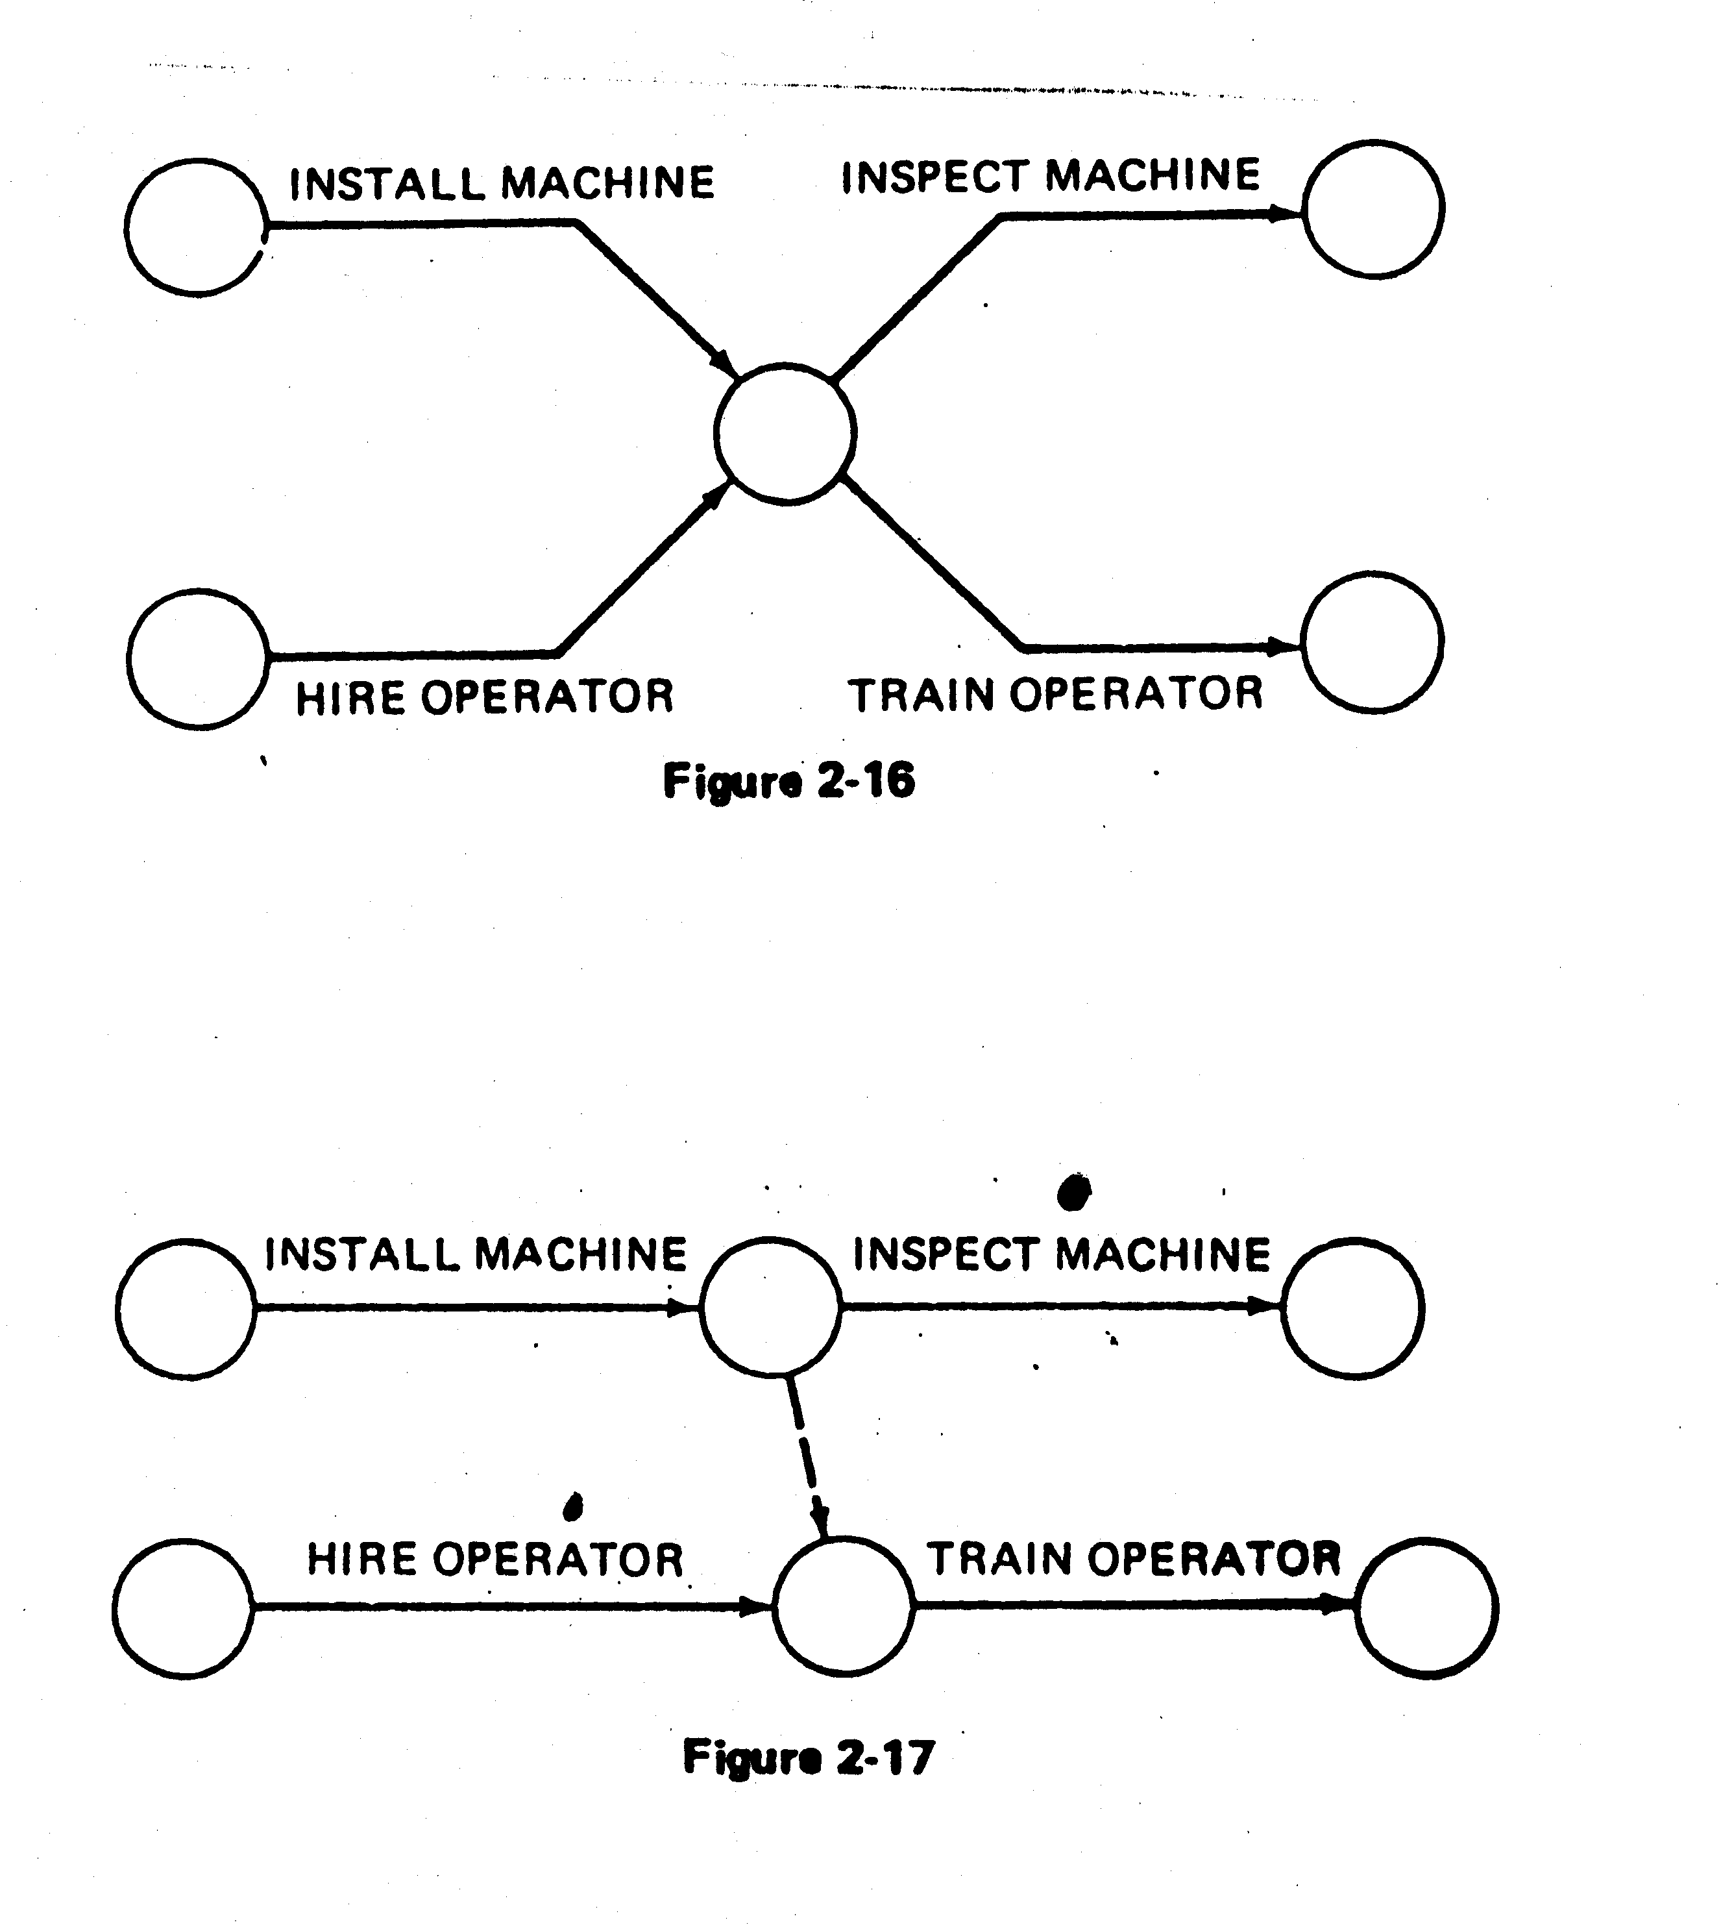
EXAMPLES OF THE USE OF DUMMYACTIVITY
Network concurrent activities
a
a
2
1
2
1
Dummy
b
b
3
WRONG!!!
RIGHT ✓
Activity c not required for e
WRONG !
a
a
d
e
1
b
1
e
b
c
d
2
c
WRONG!!!
RIGHT ✓
RIGHT ✓
Chapter 8
Scheduling, PERT, Critical Path Analysis

Slide 16
WRONG!!!
RIGHT!!!
a
d
a
d
1
1
b
e
b
2
2
4
e
c
f
c
3
f
3
a precedes d.
a and b precede e,
b and c precede f (a does not precede f)
Chapter 8
Scheduling, PERT, Critical Path Analysis

Slide 17
Scheduling with activity time
Activity Immediate Completion
predecessors Time (week)
A - 5
B - 6
C A 4
D A 3
E A 1
F E 4
G D,F 14
H B,C 12
I G,H 2
Total …… 51
This information indicates that the total time required to complete activities is 51 weeks. However, we can see from the network that several of the activities can be conducted simultaneously (A and B, for example).
Chapter 8
Scheduling, PERT, Critical Path Analysis

Slide 18
Earliest start & earliest finish time
We are interested in the longest path through the network, i.e., the critical path.
Starting at the network’s origin (node 1) and using a starting time of 0, we compute an earliest start (ES) and earliest finish (EF) time for each activity in the network.
The expression EF = ES + t can be used to find the earliest finish time for a given activity.
For example, for activity A, ES = 0 and t = 5; thus the earliest finish time for activity A is
EF = 0 + 5 = 5
Chapter 8
Scheduling, PERT, Critical Path Analysis

Slide 19
Arc with ES & EF time
EF = earliest finish time
ES = earliest start time
Activity
2
A [0,5]
5
1
t = expected activity
time
Chapter 8
Scheduling, PERT, Critical Path Analysis

Slide 20
Network with ES & EF time
D[5,8]
3
5
2
F[6,10]
4
G[10,24]
14
A[0,5]
5
E[5,6]
1
7
C[5,9]
4
4
I[24,26]
2
1
6
B[0,6]
6
H[9,21]
12
3
Earliest start time rule:
The earliest start time for an activity leaving a particular node is equal to the largest of the earliest finish times for all activities entering the node.
Chapter 8
Scheduling, PERT, Critical Path Analysis

Slide 21
Activity, duration, ES, EF, LS, LF
EF = earliest finish time
ES = earliest start time
Activity
3
C [5,9]
4 [8,12]
2
LF = latest finish time
LS = latest start time
Chapter 8
Scheduling, PERT, Critical Path Analysis

Slide 22
Latest start & latest finish time
To find the critical path we need a backward pass calculation.
Starting at the completion point (node 7) and using a latest
finish time (LF) of 26 for activity I, we trace back through the
network computing a latest start (LS) and latest finish time
for each activity
The expression LS = LF – t can be used to calculate latest start
time for each activity. For example, for activity I, LF = 26 and t
= 2, thus the latest start time for activity I is
LS = 26 – 2 = 24
Chapter 8
Scheduling, PERT, Critical Path Analysis

Slide 23
Network with LS & LF time
D[5,8]
3[7,10]
5
2
G[10,24] 14[10,24]
F[6,10]
4[6,10]
A[0,5]
5[0,5]
E[5,6]
1[5,6]
7
4
I[24,26]
2[24,26]
C[5,9]
4[8,12]
1
6
B[0,6]
6[6,12]
H[9,21]
12[12,24]
3
Latest finish time rule:
The latest finish time for an activity entering a particular node is equal to the smallest of the latest start times for all activities leaving the node.
Chapter 8
Scheduling, PERT, Critical Path Analysis

Slide 24
Slack or Free Time or Float
Slack is the length of time an activity can be delayed without affecting the completion date for the entire project.
For example, slack for C = 3 weeks, i.e Activity C can be delayed up to 3 weeks
(start anywhere between weeks 5 and 8).
3
C [5,9]
4 [8,12]
2
ES
5
LS
8
EF
9
EF
12
LF-EF = 12 –9 =3
LS-ES = 8 – 5 = 3
LF-ES-t = 12-5-4 = 3
Chapter 8
Scheduling, PERT, Critical Path Analysis

Slide 25
Activity schedule for our example
Activity | Earliest start (ES) | Latest start (LS) | Earliest finish (EF) | Latest finish (LF) | Slack (LS-ES) | Critical path
A | 0 | 0 | 5 | 5 | 0 | Yes
B | 0 | 6 | 6 | 12 | 6
C | 5 | 8 | 9 | 12 | 3
D | 5 | 7 | 8 | 10 | 2
E | 5 | 5 | 6 | 6 | 0 | Yes
F | 6 | 6 | 10 | 10 | 0 | Yes
G | 10 | 10 | 24 | 24 | 0 | Yes
H | 9 | 12 | 21 | 24 | 3
I | 24 | 24 | 26 | 26 | 0 | Yes
Chapter 8
Scheduling, PERT, Critical Path Analysis

Slide 26
IMPORTANT QUESTIONS
What is the total time to complete the project?
  26 weeks if the individual activities are completed on schedule.
What are the scheduled start and completion times for each activity?
  ES, EF, LS, LF are given for each activity.
What activities are critical and must be completed as scheduled in order to keep the project on time?
  Critical path activities: A, E, F, G, and I.
How long can non-critical activities be delayed before they cause a delay in the project’s completion time
  Slack time available for all activities are given.
Chapter 8
Scheduling, PERT, Critical Path Analysis

Slide 27
Importance of Float (Slack) and Critical Path
Slack or Float shows how much allowance each activity has, i.e how long it can be delayed without affecting completion date of project
Critical path is a sequence of activities from start to finish with zero slack. Critical activities are activities on the critical path.
Critical path identifies the minimum time to complete project
If any activity on the critical path is shortened or extended, project time will be shortened or extended accordingly
Chapter 8
Scheduling, PERT, Critical Path Analysis

Slide 28
Importance of Float (Slack) and Critical Path (cont)
So, a lot of effort should be put in trying to control activities along this path, so that project can meet due date. If any activity is lengthened, be aware that project will not meet deadline and some action needs to be taken.
6. If can spend resources to speed up some activity, do so only for critical activities.
7. Don’t waste resources on non-critical activity, it will not shorten the project time.
8. If resources can be saved by lengthening some activities, do so for non-critical activities, up to limit of float.
9. Total Float belongs to the path
Chapter 8
Scheduling, PERT, Critical Path Analysis

Slide 29
PERT For Dealing With Uncertainty
So far, times can be estimated with relative certainty, confidence
For many situations this is not possible, e.g Research, development, new products and projects etc.
Use 3 time estimates
  m= most likely time estimate, mode.
  a = optimistic time estimate,
  b = pessimistic time estimate, and
  Expected Value (TE) = (a + 4m + b) /6
  Variance (V) = ( ( b – a) / 6 ) ²
  Std Deviation (δ) = SQRT (V)
Chapter 8
Scheduling, PERT, Critical Path Analysis

Slide 30
Precedences And Project Activity Times
Immediate Optimistic Most Likely Pessimistic EXP Var S.Dev
Activity Predecessor Time Time Time TE V σ
a - 10 22 22 20 4 2
b - 20 20 20 20 0 0
c - 4 10 16 10 4 2
d a 2 14 32 15 25 5
e b,c 8 8 20 10 4 2
f b,c 8 14 20 14 4 2
g b,c 4 4 4 4 0 0
h c 2 12 16 11 5.4 2.32
I g,h 6 16 38 18 28.4 5.33
j d,e 2 8 14 8 4 2
Chapter 8
Scheduling, PERT, Critical Path Analysis

Slide 31
The complete network
2
d
(15,25)
6
j
(8,4)
a
(20,4)
e
(10,4)
1
3
f
(14,4)
7
b
(20,0)
c
(10,4)
g
(4,0)
i
(18,28.4)
4
h
(11,5.4)
5
Chapter 8
Scheduling, PERT, Critical Path Analysis

Slide 32
Figure 8-13 The complete Network
EF=20
35
2
d
(15,25)
6
a
(20,4)
j
(8,4)
b
(20,0)
e
(10,4)
43
20
1
3
f
(14,4)
7
CRIT. TIME = 43
g
(4,0)
c
(10,4)
i
(18,28.4)
4
h
(11,5.4)
5
10
24
Chapter 8
Scheduling, PERT, Critical Path Analysis

Slide 33
Critical Path Analysis (PERT)
Activity | LS | ES | Slacks | Critical ?
a | 0 | 0 | 0 | Yes
b | 1 | 0 | 1
c | 4 | 0 | 4
d | 20 | 20 | 0 | Yes
e | 25 | 20 | 5
f | 29 | 20 | 9
g | 21 | 20 | 1
h | 14 | 10 | 4
i | 25 | 24 | 1
j | 35 | 35 | 0 | Yes
Chapter 8
Scheduling, PERT, Critical Path Analysis

Slide 34
Assume, PM promised to complete the project in the fifty days.
What are the chances of meeting that deadline?
Calculate Z, where
Z = (D-S) / √V
Example,
D = 50; S(Scheduled date) = 20+15+8 =43; V = (4+25+4) =33
Z = (50 – 43) / 5.745
= 1.22 standard deviations.
The probability value of Z = 1.22, is 0.888
1.22
Chapter 8
Scheduling, PERT, Critical Path Analysis

Slide 35
What deadline are you 95% sure of meeting
Z value associated with 0.95 is 1.645
D = S + 5.745 (1.645)
= 43 + 9.45
= 52.45 days
Thus, there is a 95 percent chance of finishing the project by 52.45 days.
Chapter 8
Scheduling, PERT, Critical Path Analysis

Slide 36
Comparison Between CPM and PERT
 | CPM | PERT
1 | Uses network, calculate float or slack, identify critical path and activities, guides to monitor and controlling project | Same as CPM
2 | Uses one value of activity time | Requires 3 estimates of activity time Calculates mean and variance of time
3 | Used where times can be estimated with confidence, familiar activities | Used where times cannot be estimated with confidence. Unfamiliar or new activities
4 | Minimizing cost is more important | Meeting time target or estimating percent completion is more important
5 | Example: construction projects, building one off machines, ships, etc | Example: Involving new activities or products, research and development etc
Chapter 8
Scheduling, PERT, Critical Path Analysis

Slide 37
BENEFITS OFCPM / PERT NETWORK
  Consistent framework for planning, scheduling, monitoring, and controlling project.
  Shows interdependence of all tasks, work packages, and work units.
  Helps proper communications between departments and functions.
  Determines expected project completion date.
  Identifies so-called critical activities, which can delay the project completion time.
Chapter 8
Scheduling, PERT, Critical Path Analysis

Slide 38
BENEFITS OFCPM / PERT NETWORK (cont.)
  Identified activities with slacks that can be delayed for specified periods without penalty, or from which resources may be temporarily borrowed
  Determines the dates on which tasks may be started or must be started if the project is to stay in schedule.
  Shows which tasks must be coordinated to avoid resource or timing conflicts.
  Shows which tasks may run in parallel to meet project completion date
Chapter 8
Scheduling, PERT, Critical Path Analysis

Slide 39
Gantt Charts
Since 1917; Useful for showing work vs time in form of bar charts
e.g.
  Can draw directly or from CPM/PERT network
Chapter 8
Scheduling, PERT, Critical Path Analysis

Slide 40
Modified PERT/CPM diagram from network
a
d
1
2
6
7
Legend
Scheduled Start
Scheduled Finish
Actual Progress
Unavailable
Current Date
Milestone Scheduled
Milestone Achieved
e
3
3
f
1
b
3
5
1
c
4
dummy
h
4
0
5
10
15
20
25
30
35
40
45
Days
Chapter 8
Scheduling, PERT, Critical Path Analysis

Slide 41
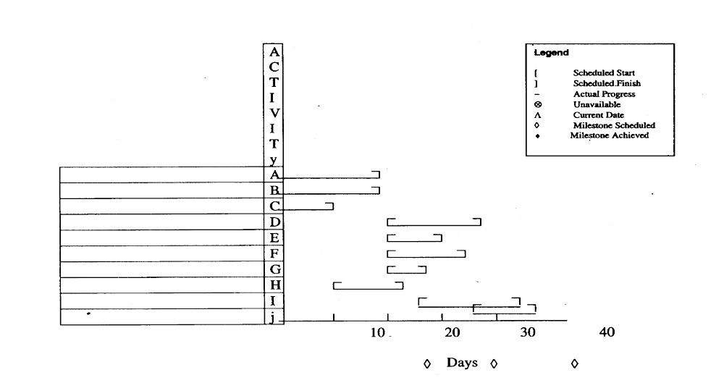
GANTT CHART
Chapter 8
Scheduling, PERT, Critical Path Analysis

Slide 42
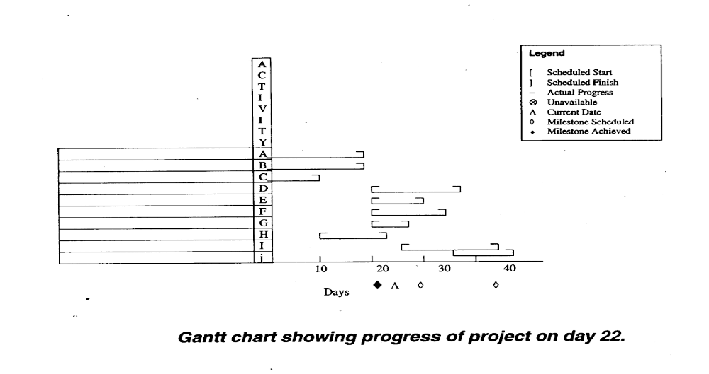
Chapter 8
Scheduling, PERT, Critical Path Analysis

Slide 43
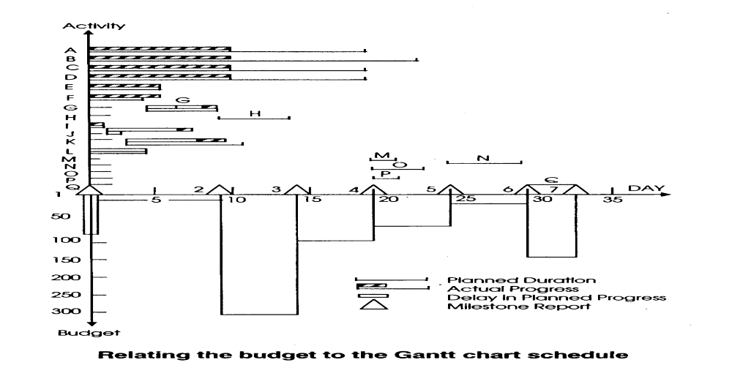
Chapter 8
Scheduling, PERT, Critical Path Analysis

Slide 44
Gantt Charts and CPM/PERT Networks
Gantt Charts:
Even though a lot of info, easy to read and , understand to monitor and follow progress.
Not very good for logical constraints
Should be used to COMPLEMENT networks, not replace
Chapter 8
Scheduling, PERT, Critical Path Analysis

Slide 45
RESOURCE ANALYSIS AND SCHEDULING
Ability to carry out projects depend on the availability of resources
Analyze resource implication
  -How requirements can be met and changes needed
Use resources efficiently
Use network to give information about time, resources and cost
Chapter 8
Scheduling, PERT, Critical Path Analysis

Slide 46
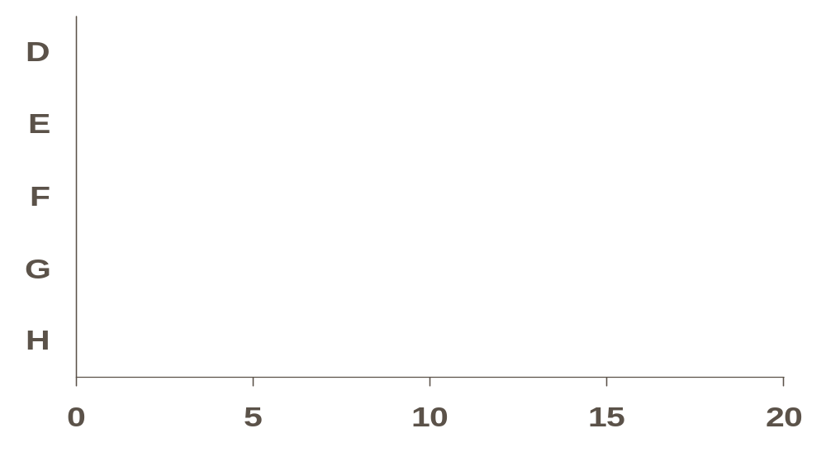
Activities D, E, F, G and H require fitters.
Construct a bar chart with activities at their EST indicating
person required and total float.
2 2 2 2 2 2 2 2
2 2 2 2 2 2
Activity
2 2
2 2 2 2
4 4 4 4 4 4 4 4 4 4 4 4
Time
Add up across all activities to get the total number of men
required.
Chapter 8
Scheduling, PERT, Critical Path Analysis

Slide 47
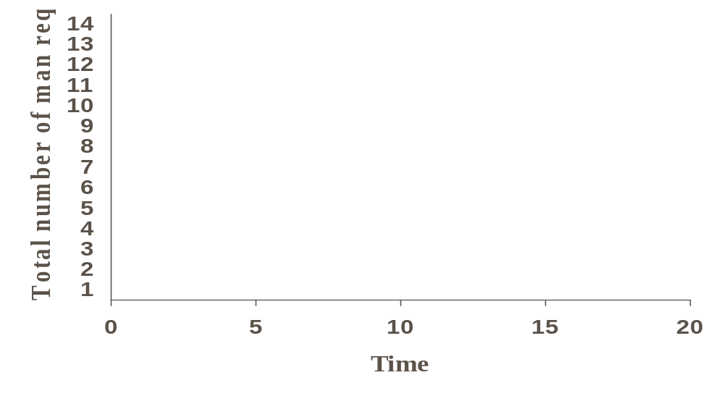
Convert the bar chart to a histogram
Resource analysis before scheduling
Shows: i) Variation from week to week (fitters)
ii) Maximum number of person required (12) during
week 5-6
Examine resource implication.
Chapter 8
Scheduling, PERT, Critical Path Analysis

Slide 48
Example
If only 8 fitters are available at any period during the projects:
New bar chart:
2 2 2 2 2 2 2 2
2 2 2 2 2 2
Activity
2 2
2 2 2 2
4 4 4 4 4 4 4 4 4 4 4 4
Time
Chapter 8
Scheduling, PERT, Critical Path Analysis

Slide 49
Additional Restriction – no fitters available until the end of
week 5.
Revised Schedule:
2 2 2 2 2 2 2 2
2 2 2 2 2 2
Activity
2 2
2 2 2 2
4 4 4 4 4 4 4 4 4 4 4 4
Time
Chapter 8
Scheduling, PERT, Critical Path Analysis

Slide 50
Resource constraints relates to:
Variations in resource requirements
Resource availability
Smaller variations:
Easier control of the job
Better utilization of resources
Big variations:
Frequent moving of manpower
Require close control
Affect efficiency
Chapter 8
Scheduling, PERT, Critical Path Analysis

Slide 51
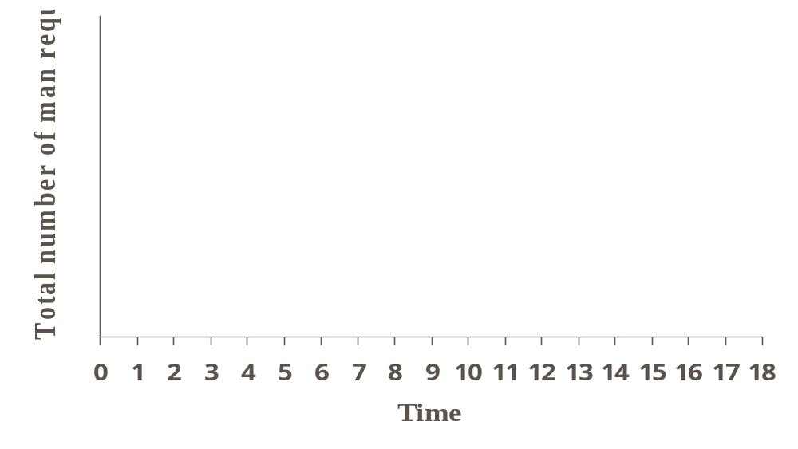
Histogram showing large resource variations
Chapter 8
Scheduling, PERT, Critical Path Analysis

